Slide 1
Chapter 5
Large and Fast: Exploiting Memory Hierarchy
Notes:
Morgan Kaufmann Publishers
Chapter 5 — Large and Fast: Exploiting Memory Hierarchy

Slide 2
Cache Design Trade-offs
Design change | Effect on miss rate | Negative performance effect
Increase cache size | Decrease capacity misses | May increase access time
Increase associativity | Decrease conflict misses | May increase access time
Increase block size | Decrease compulsory misses | Increases miss penalty. For very large block size, may increase miss rate due to pollution.
Chapter 5 — Large and Fast: Exploiting Memory Hierarchy — <number>
Notes:
Morgan Kaufmann Publishers
Chapter 5 — Large and Fast: Exploiting Memory Hierarchy

Slide 3
Cache Control
Example cache characteristics
  Direct-mapped, write-back, write allocate
  Block size: 4 words (16 bytes)
  Cache size: 16 KB (1024 blocks)
  32-bit byte addresses
  Valid bit and dirty bit per block
  Blocking cache
    CPU waits until access is complete
§5.9 Using a Finite State Machine to Control A Simple Cache
31
14
13
4
3
0
Tag
Index
Offset
18 bits
10 bits
4 bits
Chapter 5 — Large and Fast: Exploiting Memory Hierarchy — <number>
Notes:
Morgan Kaufmann Publishers
Chapter 5 — Large and Fast: Exploiting Memory Hierarchy

Slide 4
Interface Signals
CPU
Cache
Memory
Read/Write
Read/Write
Valid
Valid
Address
32
Address
32
Write Data
32
Write Data
128
Read Data
32
Read Data
128
Ready
Ready
Multiple cycles per access
Chapter 5 — Large and Fast: Exploiting Memory Hierarchy — <number>
Notes:
Morgan Kaufmann Publishers
Chapter 5 — Large and Fast: Exploiting Memory Hierarchy

Slide 5

Finite State Machines
Use an FSM to sequence control steps
Set of states, transition on each clock edge
  State values are binary encoded
  Current state stored in a register
  Next state
  = f_{n} (current state,
  current inputs)
Control output signals
= f_{o} (current state)
Chapter 5 — Large and Fast: Exploiting Memory Hierarchy — <number>
Notes:
Morgan Kaufmann Publishers
Chapter 5 — Large and Fast: Exploiting Memory Hierarchy

Slide 6

Cache Controller FSM
Could partition into separate states to reduce clock cycle time
Chapter 5 — Large and Fast: Exploiting Memory Hierarchy — <number>
Notes:
Morgan Kaufmann Publishers
Chapter 5 — Large and Fast: Exploiting Memory Hierarchy

Slide 7
Cache Coherence Problem
Suppose two CPU cores share a physical address space
  Write-through caches
Time step | Event | CPU A’s cache | CPU B’s cache | Memory
0 |  |  |  | 0
1 | CPU A reads X | 0 |  | 0
2 | CPU B reads X | 0 | 0 | 0
3 | CPU A writes 1 to X | 1 | 0 | 1
§5.10 Parallelism and Memory Hierarchies: Cache Coherence
Chapter 5 — Large and Fast: Exploiting Memory Hierarchy — <number>
Notes:
Morgan Kaufmann Publishers
Chapter 5 — Large and Fast: Exploiting Memory Hierarchy

Slide 8
Coherence Defined
Informally: Reads return most recently written value
Formally:
  P writes X; P reads X (no intervening writes)
  ⇒ read returns written value
  P₁ writes X; P₂ reads X (sufficiently later)
  ⇒ read returns written value
    c.f. CPU B reading X after step 3 in example
  P₁ writes X, P₂ writes X
  ⇒ all processors see writes in the same order
    End up with the same final value for X
Chapter 5 — Large and Fast: Exploiting Memory Hierarchy — <number>
Notes:
Morgan Kaufmann Publishers
Chapter 5 — Large and Fast: Exploiting Memory Hierarchy

Slide 9
Cache Coherence Protocols
Operations performed by caches in multiprocessors to ensure coherence
  Migration of data to local caches
    Reduces bandwidth for shared memory
  Replication of read-shared data
    Reduces contention for access
Snooping protocols
  Each cache monitors bus reads/writes
Directory-based protocols
  Caches and memory record sharing status of blocks in a directory
Chapter 5 — Large and Fast: Exploiting Memory Hierarchy — <number>
Notes:
Morgan Kaufmann Publishers
Chapter 5 — Large and Fast: Exploiting Memory Hierarchy

Slide 10
Invalidating Snooping Protocols
Cache gets exclusive access to a block when it is to be written
  Broadcasts an invalidate message on the bus
  Subsequent read in another cache misses
    Owning cache supplies updated value
CPU activity | Bus activity | CPU A’s cache | CPU B’s cache | Memory
 |  |  |  | 0
CPU A reads X | Cache miss for X | 0 |  | 0
CPU B reads X | Cache miss for X | 0 | 0 | 0
CPU A writes 1 to X | Invalidate for X | 1 |  | 0
CPU B read X | Cache miss for X | 1 | 1 | 1
Chapter 5 — Large and Fast: Exploiting Memory Hierarchy — <number>
Notes:
Morgan Kaufmann Publishers
Chapter 5 — Large and Fast: Exploiting Memory Hierarchy

Slide 11
Memory Consistency
When are writes seen by other processors
  “Seen” means a read returns the written value
  Can’t be instantaneously
Assumptions
  A write completes only when all processors have seen it
  A processor does not reorder writes with other accesses
Consequence
  P writes X then writes Y
  ⇒ all processors that see new Y also see new X
  Processors can reorder reads, but not writes
Chapter 5 — Large and Fast: Exploiting Memory Hierarchy — <number>
Notes:
Morgan Kaufmann Publishers
Chapter 5 — Large and Fast: Exploiting Memory Hierarchy

Slide 12
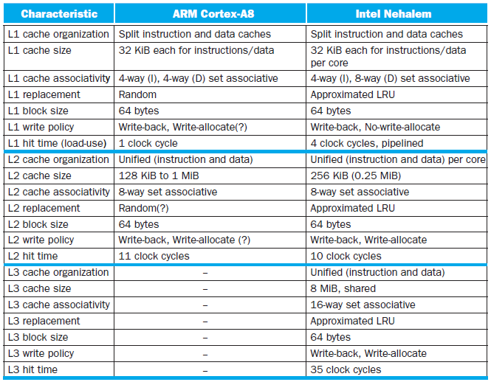
Multilevel On-Chip Caches
§5.13 The ARM Cortex-A8 and Intel Core i7 Memory Hierarchies
Chapter 5 — Large and Fast: Exploiting Memory Hierarchy — <number>
Notes:
Morgan Kaufmann Publishers
Chapter 5 — Large and Fast: Exploiting Memory Hierarchy

Slide 13
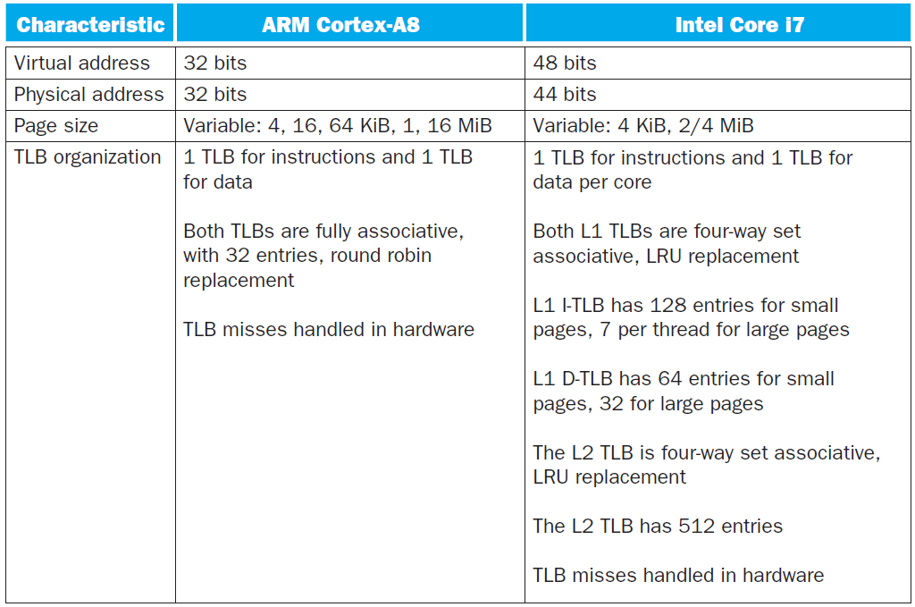
2-Level TLB Organization
Chapter 5 — Large and Fast: Exploiting Memory Hierarchy — <number>
Notes:
Morgan Kaufmann Publishers
Chapter 5 — Large and Fast: Exploiting Memory Hierarchy

Slide 14
Supporting Multiple Issue
Both have multi-banked caches that allow multiple accesses per cycle assuming no bank conflicts
Core i7 cache optimizations
  Return requested word first
  Non-blocking cache
    Hit under miss
    Miss under miss
  Data prefetching
Chapter 5 — Large and Fast: Exploiting Memory Hierarchy — <number>
Notes:
Morgan Kaufmann Publishers
Chapter 5 — Large and Fast: Exploiting Memory Hierarchy

Slide 15

DGEMM
Combine cache blocking and subword parallelism
§5.14 Going Faster: Cache Blocking and Matrix Multiply
Chapter 5 — Large and Fast: Exploiting Memory Hierarchy — <number>

Slide 16
Pitfalls
Byte vs. word addressing
  Example: 32-byte direct-mapped cache,
  4-byte blocks
    Byte 36 maps to block 1
    Word 36 maps to block 4
Ignoring memory system effects when writing or generating code
  Example: iterating over rows vs. columns of arrays
  Large strides result in poor locality
§5.15 Fallacies and Pitfalls
Chapter 5 — Large and Fast: Exploiting Memory Hierarchy — <number>
Notes:
Morgan Kaufmann Publishers
Chapter 5 — Large and Fast: Exploiting Memory Hierarchy

Slide 17
Pitfalls
In multiprocessor with shared L2 or L3 cache
  Less associativity than cores results in conflict misses
  More cores ⇒ need to increase associativity
Using AMAT to evaluate performance of out-of-order processors
  Ignores effect of non-blocked accesses
  Instead, evaluate performance by simulation
Chapter 5 — Large and Fast: Exploiting Memory Hierarchy — <number>
Notes:
Morgan Kaufmann Publishers
Chapter 5 — Large and Fast: Exploiting Memory Hierarchy

Slide 18
Pitfalls
Extending address range using segments
  E.g., Intel 80286
  But a segment is not always big enough
  Makes address arithmetic complicated
Implementing a VMM on an ISA not designed for virtualization
  E.g., non-privileged instructions accessing hardware resources
  Either extend ISA, or require guest OS not to use problematic instructions
Chapter 5 — Large and Fast: Exploiting Memory Hierarchy — <number>
Notes:
Morgan Kaufmann Publishers
Chapter 5 — Large and Fast: Exploiting Memory Hierarchy

Slide 19
Concluding Remarks
Fast memories are small, large memories are slow
  We really want fast, large memories ☹
  Caching gives this illusion ☺
Principle of locality
  Programs use a small part of their memory space frequently
Memory hierarchy
  L1 cache ↔ L2 cache ↔ … ↔ DRAM memory
  ↔ disk
Memory system design is critical for multiprocessors
§5.16 Concluding Remarks
Chapter 5 — Large and Fast: Exploiting Memory Hierarchy — <number>
Notes:
Morgan Kaufmann Publishers
Chapter 5 — Large and Fast: Exploiting Memory Hierarchy

